Slide 1
Ratings Prediction

Slide 2
Submitted by :
Utkarsha Jadhav

Slide 3
Review Rating Prediction attempts to infer from the review's content the user's numerical rating (often between 1 and 5 stars). Helping website visitors determine the rating of their reviews is a good usage of the Rating Prediction job. Recognize phoney or dubious online reviews.
Problem objective

Slide 4
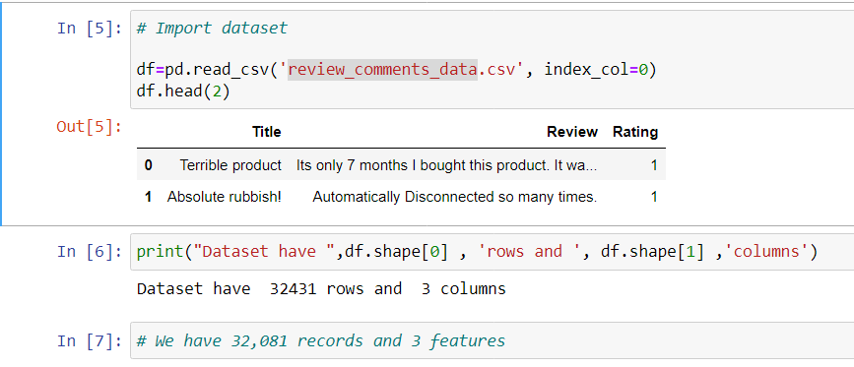
Importing data
We have scrapped data using selenium from different websites and saved the data into a csv format file named review_comments_data.csv

Slide 5
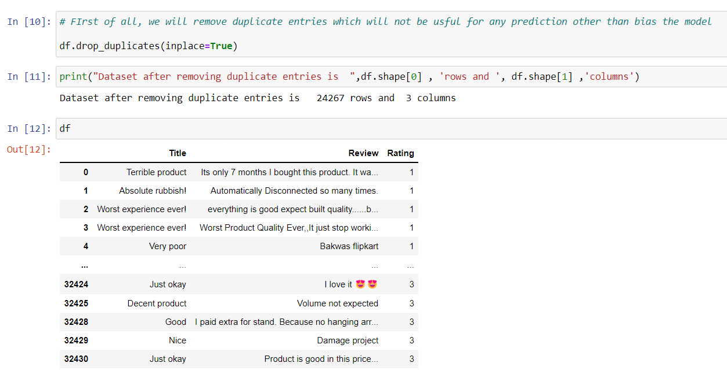
Removing Duplicates from dataset

Slide 6
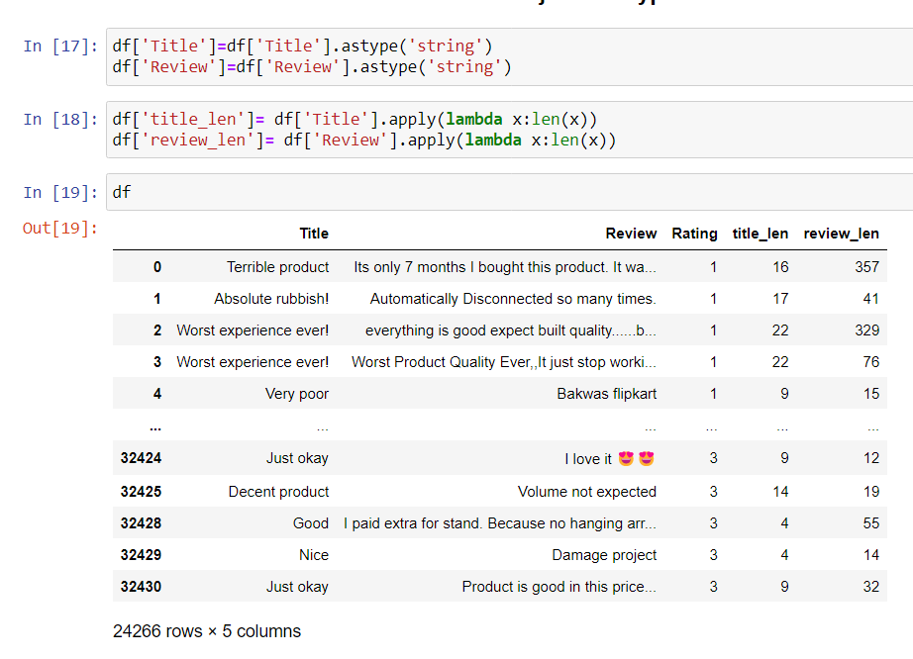
Checking data type and converting it

Slide 7
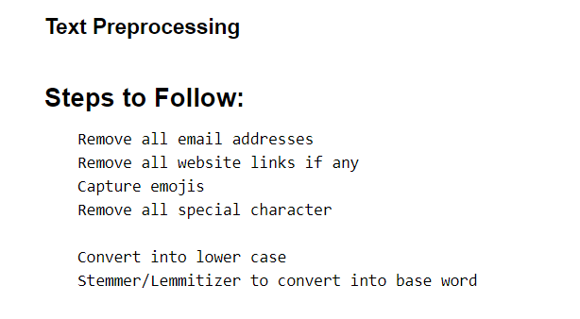
Using NLP techniques for Data Preprocessing

Slide 8
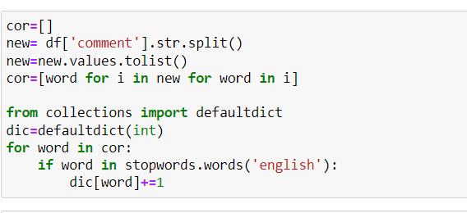
Using corpus library In NLP

Slide 9
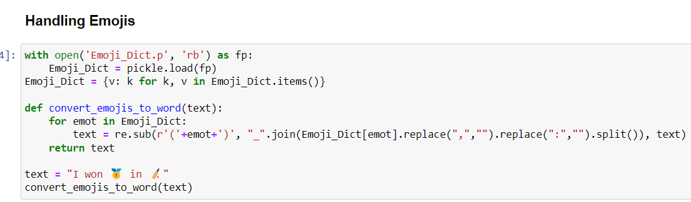
Handling Emojis

Slide 10
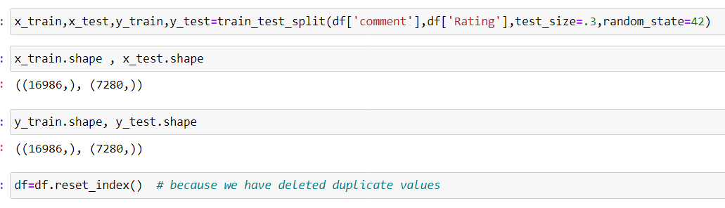
Splitting data into train and test

Slide 11
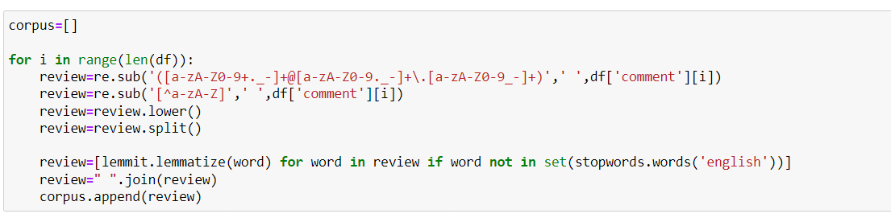
More Data preprocessing methods

Slide 12
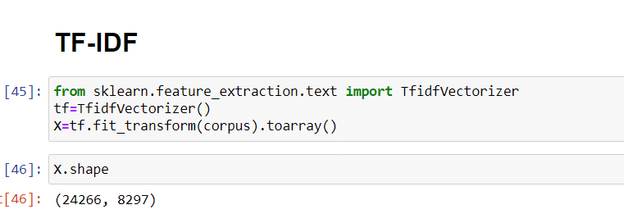
Convert word into vectors using TF-IDF

Slide 13
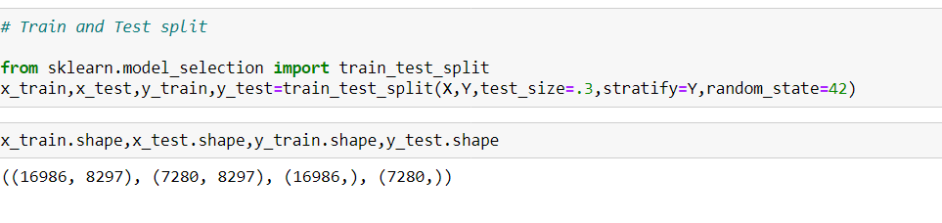
Machine Learning

Slide 14
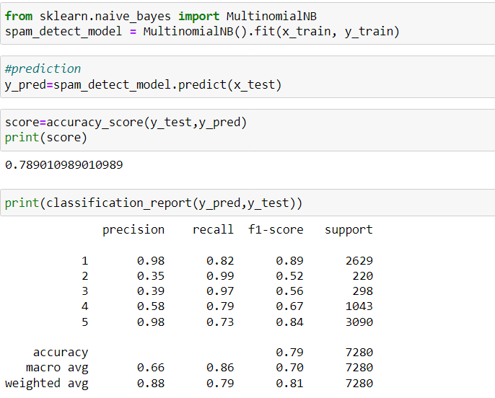
Using Multinomial DB

Slide 15
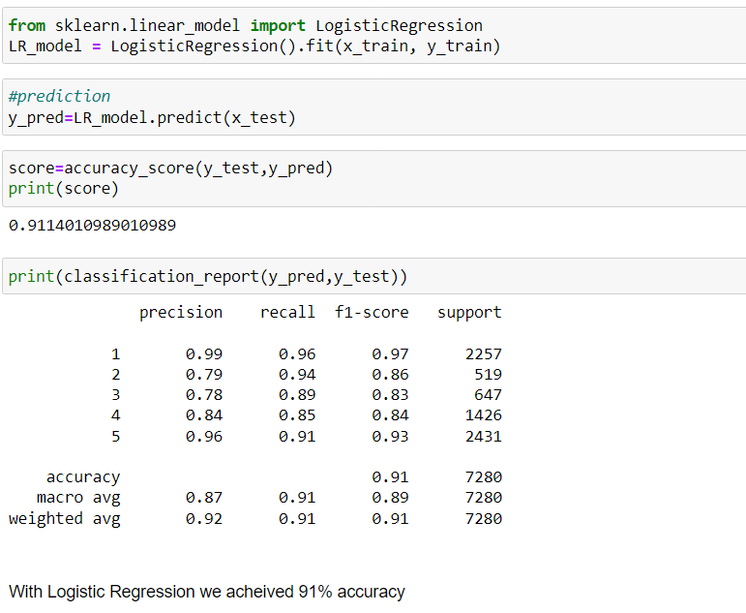
Using Logistic Regression

Slide 16
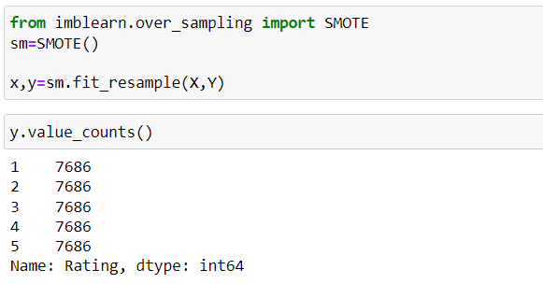
Balacing Dataset with SMOTE
We can see that now other dataset is balanced each record has 7686 data in it.

Slide 17
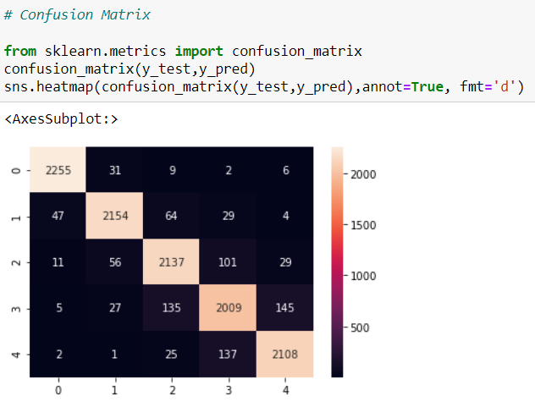
Confusion Matrix

Slide 18
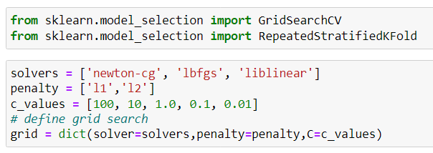
Hypertuning

Slide 19
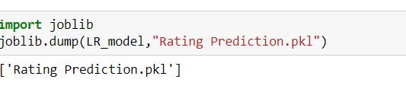
Exporting data to pkl file

Slide 20
Concluding points
Without balacinfg dataset the accuracy obtained was about 91% using Logistic Regression.
After SMOTE balancing technique the acuuracy increased by nearly 1% (92.4%).
Also use Decision Tree Classifier and SVC but its accuracy obtained is low as compared to LR(Logistic Regression).

